Slide 1


INTERMEDIATE & SENIOR PARENT MEETING

Slide 2

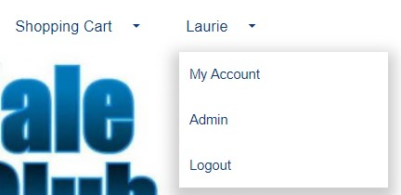
REMINDER: Your Account
Click on the drop down that reads “My Account”
Once in your account you can access your profiles
Update Contact Information
Review your participants and their evaluations or achievements
THE CALENDAR TAB while logged into your account shows all your registered skating times and events.
Invoice Tab for copies of all your registrations

Slide 3
City Subsidy
The club will need to confirm addresses of those that qualify for the city subsidy.
The subsidy covers the balance set program cost
Paying a subsidy non-qualifier fee
This amount is the same amount as what the city pays for those within their city limits
Where to address concerns

Slide 4

STORM WATCHES AND CLOSURES – in the event of storms or unforeseen closures, we will post on our website as well as send you an email. We normally only close if the facility is closed. Therefor if you see from a community posting that the arena is closed, then so are we. There is the off-chance if our administrator does not have power, they will not be able to email you. Please don’t call the arena as they are not part of our operation for detailed info.
Please keep your account contact info up to date. You can add a second email to your account if needed

Slide 5
Welcome Intermediate & Senior’s to the 2025 – 2026 Season
Your skaters are able to follow the Starskate or Podium Pathway
Depending on your skating level you are in the learn-to-train or train-to-train level of Sport for Life Long-Term development in Sport
When logged into your account with Skate Canada you can read more on Pathway choices
If you have not already, go to skatecanada.ca/members to create an account in your child’s name. This way you will be able to see their STARskate Achievements and follow their official progress.

Slide 6
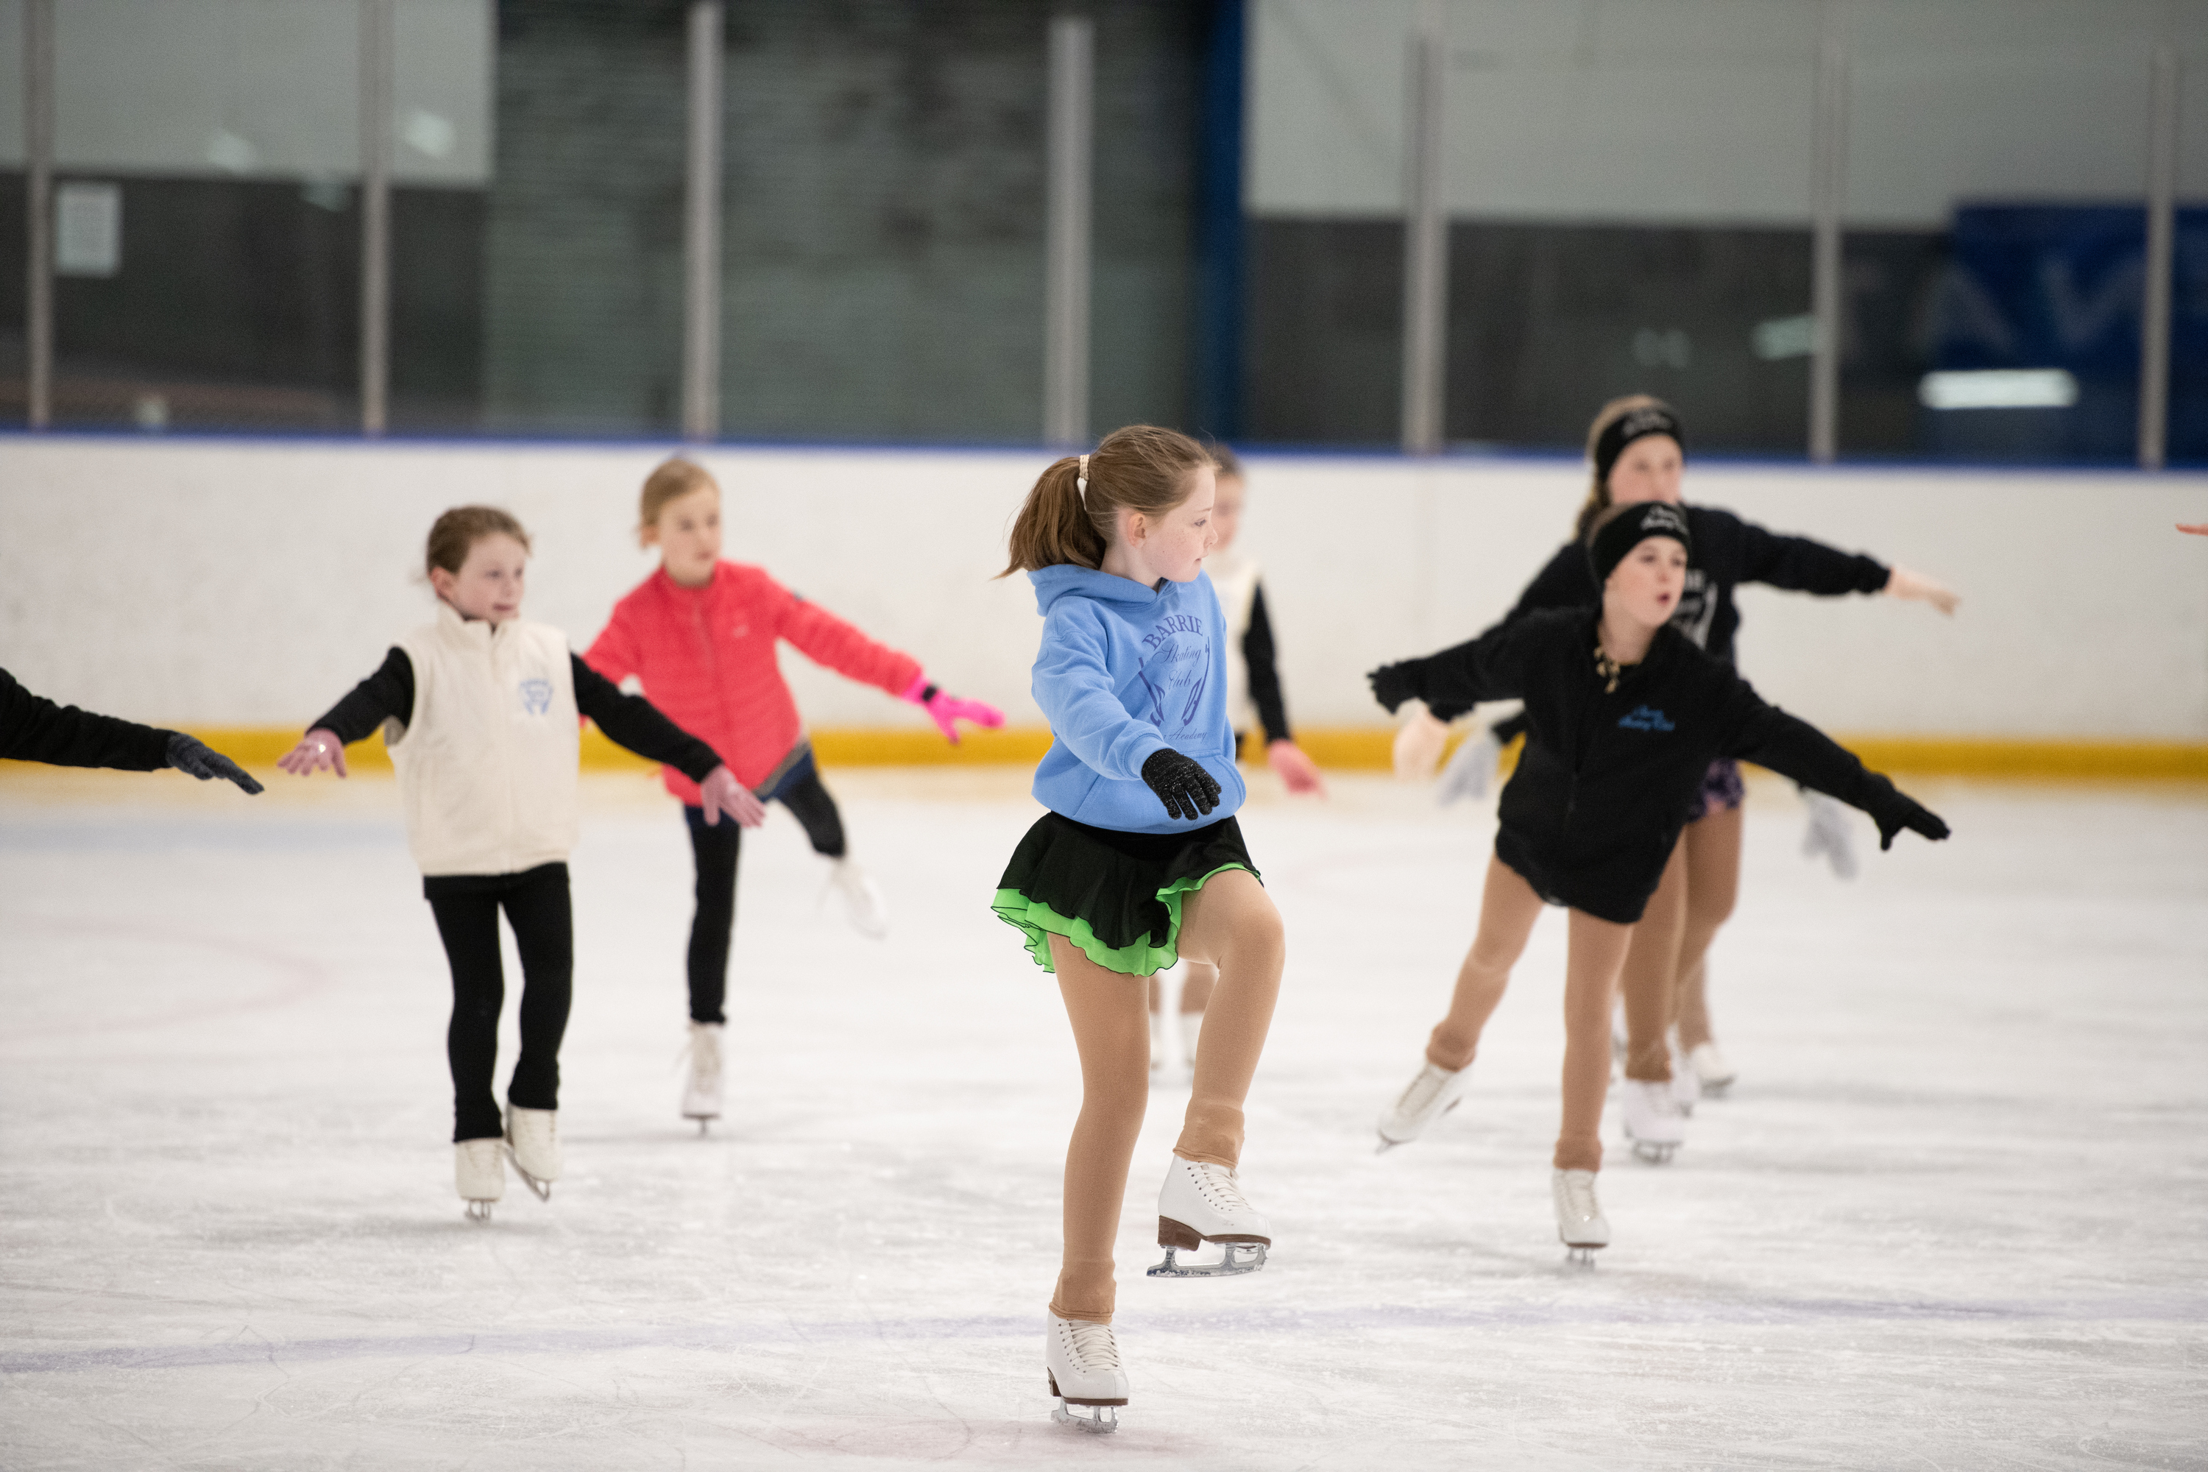
Program Specifics
Intermediates
50% group lesson time
Share the ice with Seniors (all levels on Saturdays)
New to Intermediates? Arranging Private Lessons is recommended
Focused needs of your skater, creation of freeskate solo’s for competition and development, for coaching assessment through Star 5
Seniors
15 min Group Lesson Time Daily
Partially Shared Ice with Intermediates (all levels on Saturdays)

Slide 7
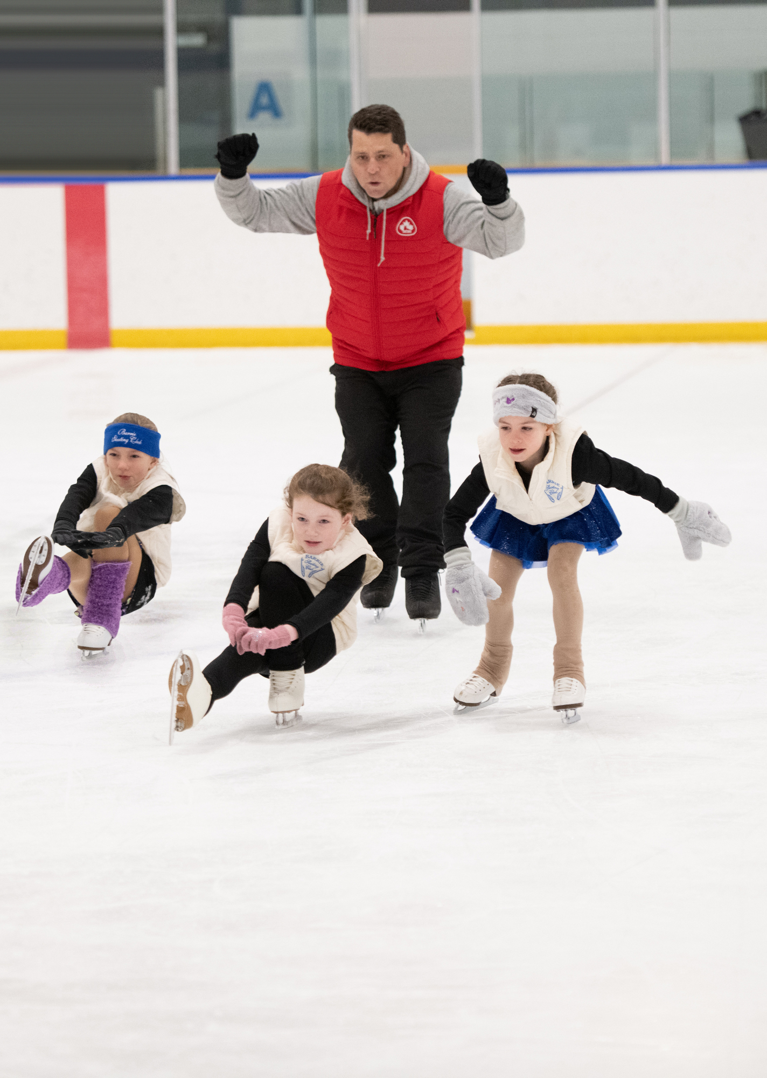
Assessments
REMINDER
If paying by CASH, you are still required to create and invoice and purchase the assessment on-line. Choose e-transfer and we will modify with receipt of payment
INCLUDE SKATERS NAME AND ASSESSMENTS TAKING ON YOUR INVOICE
INCLUDE INVOICE NUMBER ON YOUR ENVELOPE PROVIDED BY THE COACH

Slide 8
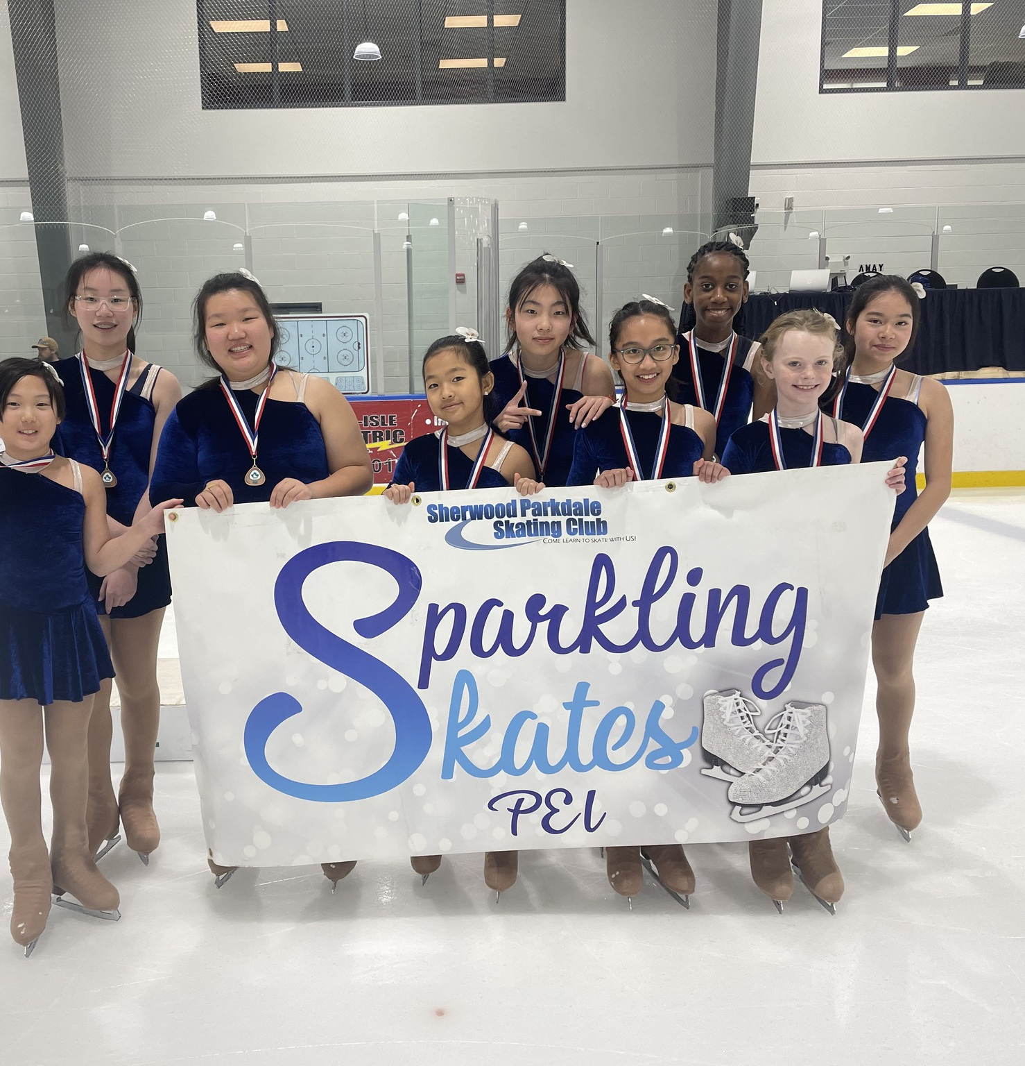
Synchro
All STARSkaters are encouraged to take part in Synchro
As part of the Skate Canada curriculum, this session is an excellent opportunity to develop skating skills in a fun and supportive atmosphere.
Or keep up your skating skills in a team environment
Our goal is to have two teams this season to welcome all level of Starskaters
The cost is $150 ($25 installments/month) as an add-on to a fulltime Starskate Registration .
Part-time Star/Synchro available on request
Synchro includes ice time, coaching, off-ice classes, the Team portion of competition registration fees
New team members will also receive a free Sychro Jacket

Slide 9
Events
2025 Fall Skate Invitational – Cody Banks Arena – Registration opens Oct 18 – 25 STAR 1 – 4 Events
2026 ADL Starskate Competition – Event is Feb 14, 2025 (Star 1 – 3)
2026 Starskate Championships February 28th
Synchro Events also on island are the Friendship Competition in January & Maritime Championships March 1st
Skaters may also go to off-island events. There are opportunities close by in NB & NS. SPSC offers funding of $100 for one off-island event
See Events under Links-Gotta-See-It-Info on our home page and discuss season competition planning with your coaches

Slide 10
Competition Hosts
Sherwood Parkdale Skating Club is part of the Island Skating Academy for programs in the off-season.
We will be hosting the 2025 PEI Fall INVITATIONAL. Volunteers will be needed at the event on Saturday, November 15th or set up on November 14th
Announcer – not limited to bilingual but would be great if you speak both English & French
Announcer back up/shadow
Videographer - everything is pre-set up, just follow the skater. No experience necessary
Ice Captains, Registration Desk, Sales

Slide 11
Program assistants AND THE STARSKATE PROGRAM
JUMPSTART
JUNIORS
PA INCENTIVE KEEPS COSTS DOWN
DID YOU KNOW YOUR PROGRAM ACTUALLY COSTS 3 TIMES AS MUCH AS WE CHARGE?
WE CAN DO THIS BY HAVING PROGRAM ASSISTANTS
WHO ARE OUR PA’S
JUNIORS & INTERMEDIATES 10YRS OF AGE AND OLDER
SENIORS OF ANY AGE

Slide 12
Healthy Kids! Active Kids! Fundraiser
Our partnership with QUEEN STREET MEAT MARKET IN CHARLOTTETOWN is back
Fundraising Policy
If you want to fill your freezers and you purchase more than 10 items, you will receive a credit on your personal account as well as helping the club overall.
Fillable Form will be sent out in an email
Hard copies are available
This is our main fundraiser for the club that puts food on tables at better than or equal to grocery store prices while helping the club keep fees affordable.

Slide 13


We are always looking for volunteers
This can be during your scheduled skating time or at special events.
We always could use someone new on the board.

Slide 14
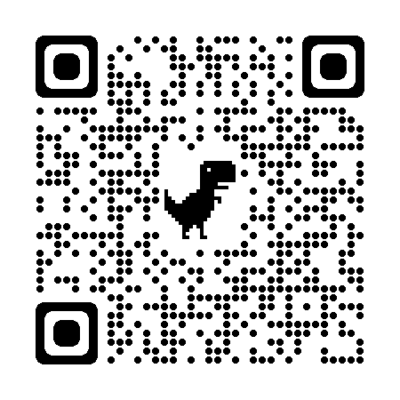
Club Apparel
We have a store available through Allstar Cresting
There are t-shirts, hoodies, outdoor jackets and more – Get in the spirit with quality merchandise. 10% goes to the club.
Here at the club, we also have mittens/gloves and a limited supply of skate guards for sale
Club competition/practice jackets are orderable through the club. Reach out to us at office@sherwoodparkdaleskatingclub.com if you are looking for an on-ice jacket. You can follow this link to our Allstar Store. This is also posted on our bulletin board.

Slide 15
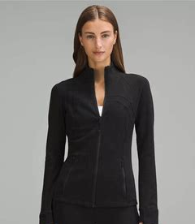
Team spirit
Club jackets are available to order. Your orders are Due by October 11th
Lululemon define jackets embroidered with the club logo and skaters Name or initials. Start at size 0
Great for both practice and competition
Youth sized are available by special order in a Lulu style jacket
Your cost: Lululemon $60 – 100 dependant on discount available: youth custom $45
The club pays the balance & the embroidery

Slide 16

Thank you

